Slide 1
Earthquake Damage Prediction Challenge
Amanda Marques
Andres Olivares
Javier Ferrando

Slide 2
Approach in Brief
We are trying to predict which buildings will be unsafe and why.
We approach this as a regression problem, where we will predict a number that is closer to the label of damage (from 1 to 5).
Reasons why we chose regression:
The ordinality of the scale; A damage that is tagged as 4 is less severe than one that is 5;
The evaluation metrics: in case our model is classifying the damages incorrectly, the RMSE would be punished unproportionally;
Imbalanced dataset; there are far more samples in class 5 than 1.

Slide 3
Data Preprocessing/Feature Engineering
Outliers:
Age of buildings: 999 years old buildings were probably a typo and only represented 0.5% of the dataset.
Data Transformation
Transformed income_range string into a numeric type, by replacing the range with its mean.
Bucketize age to get a more even distribution
Drop several variables due to correlations (see notebook for details)

Slide 4
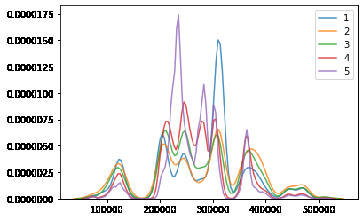
Data Insights
Ward_Ids:
- Ward_ids are adjacents to each other;
- Similar damages in a particular number of adjacents ward_ids;
- High concentration of severe damaged at specific ward_id locations.

Slide 5
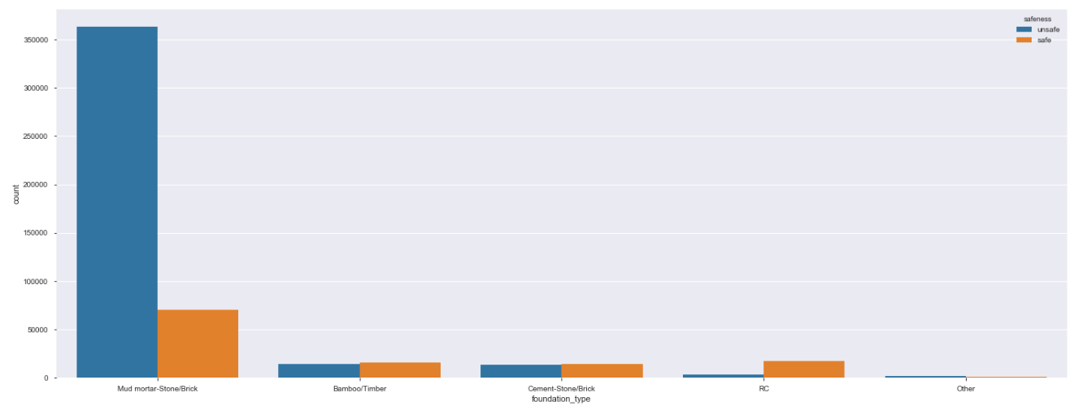
Data Insights
Foundation_type:
The most important feature in order to predict earthquake damage.
In case the building has foundation Mud mortar-Stone/Brick, the building is more likely to suffer high damages from an earthquake.
The safest floor type is Reinforced Cement (RC);

Slide 6
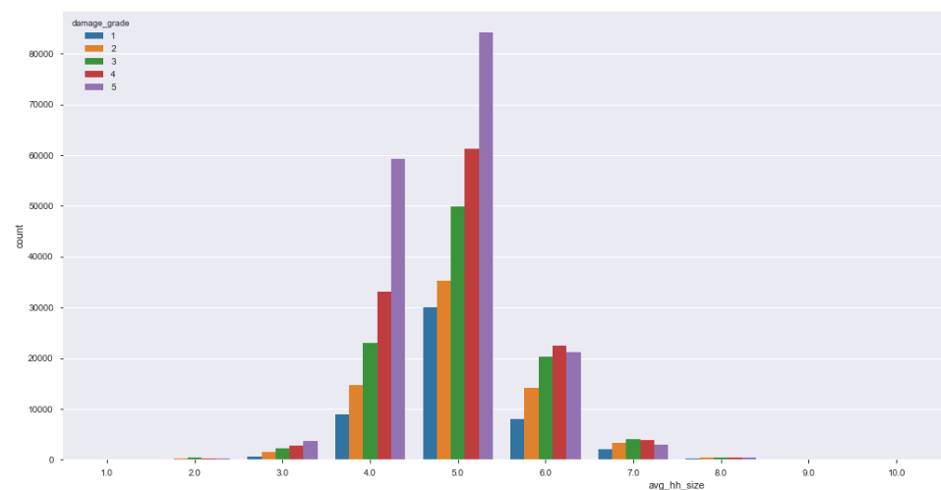
Data Insights
Average_household_size:
In contrast with the rest of the data distribution, houses that are in average 6 or 7 suffer more from damages number 4 than 5.

Slide 7
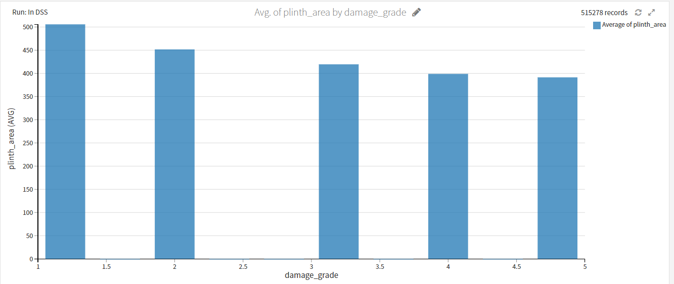
Data Insights
Plinth_area:
The higher the plinth_area, smaller the damage

Slide 8
Feature Importance
The most important features are, in order:
Ward_id
Foundation type(Mud mortar-Stone/Brick)
Plinth_area_sq_ft
Household_count
height_ft_pre_eq

Slide 9
Final Model
How does your final model look like?
Random Forest with 72 features
How did you you reach there?
We tried several regression models and Random forest gave us the best RMSE score on test set. Despite the simplicity of the Random Forest respect to more complex trees-based approaches, it performs better.

Slide 10
Specifications and Recommendations
When an earthquake occurs:
Centrate the forces in the ward_ids with more numbers of higher buildings, with foundation_type of mud and lower incomes, as such houses are the most likely to suffer severe damage.
Long term plan:
Plan to build more houses with reinforced concrete (RC) as material, avoiding the use of Mud
Avoid building on specific ward_id areas.
Actions that can be done now:
Prevention campaigns for people in dangerous areas

Slide 11
If more time was given?
More feature engineering such as defining new variables and trying their relevance
More EDA to get further data insights
Hyperparameters tuning
Usage of external data like geo-location data to correlate ward_id with specific geo-active locations.
More quantitative recommendations for the client

Slide 12


